Slide 1
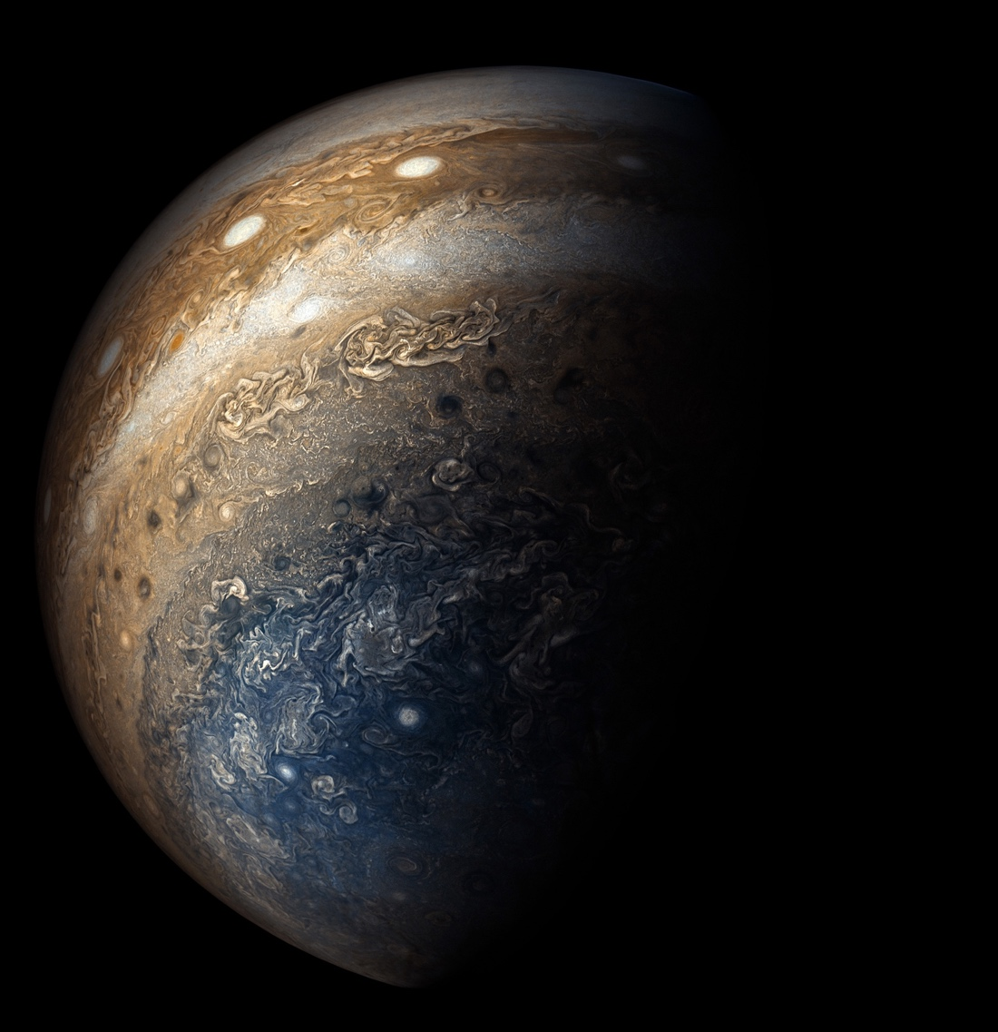
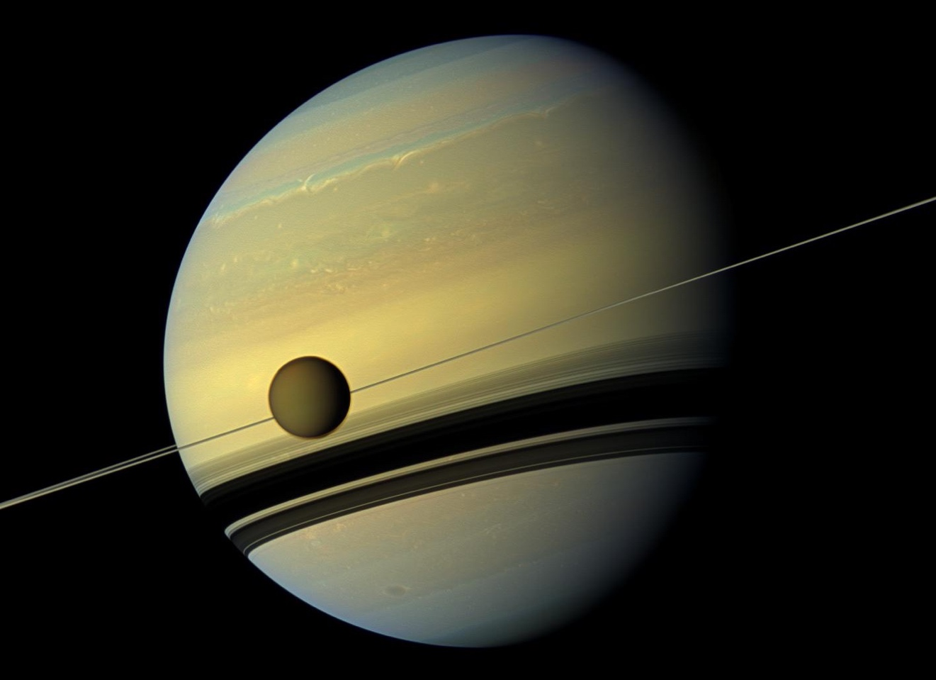
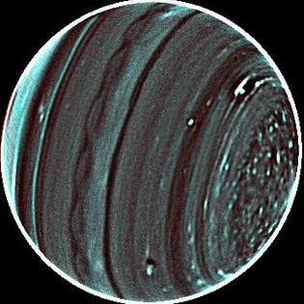

SPICA Planetary Atmospheres
Giant Planets and Titan
Leigh Fletcher, Conor Nixon, Davide Grassi, Glenn Orton, Hideo Sagawa, Emmanuel Lellouch, Matt Griffin
DPS48/EPSC11 #501.08

Slide 2
Space Infrared Telescope for Cosmology and Astrophysics (SPICA)
JAXA/ESA 2032 launch (M5 mission, Phase A from 2019-2021)
Cryogenic Telescope: Ritchey-Chretien 2.5-m primary; V-groove radiators and cryocoolers to maintain below 8 K.
Orbit: Halo orbit around L2.
Spectral coverage: 12-230 µm
SMI (SPICA Mid-infrared Instrument): 12-36 μm
SMI-LRS (Low-Resolution Spectroscopy): 17–36 μm
SMI-MRS (Mid-Resolution Spectroscopy): 18–36 μm, R=2,000
SMI-HRS (High-Resolution Spectroscopy): 12–18 μm, R=33,000
SAFARI (SPICA Far-infrared Instrument): 34–210 μm

Slide 3
Potential for Giant Planet/Titan Science
SMI/HRS:
Range is 12-18 microns (830 – 560 cm-1), with R = 33,000 and slit area 4” x 1.7” = 6.8 sq. arcsec.
Assume that the saturation limit corresponds to the product of the slit area and the planet disk-averaged surface brightness.
HRS saturation level 20,000 Jy. For Jupiter (diameter ~40”; TB » 130 K), the captured flux density is < 2 kJy at all wavelengths, so well within saturation limit.
Saturn (diameter ~20”), Uranus (diameter ~3.6”) and Neptune (diameter ~2.2”) all less bright and so observable over the whole HRS range.
SMI/MRS:
Range is 18-36 µm (278 – 560 cm-1) with R = 1300-2300 and slit area is 60” x 3.7”.
Jupiter and Saturn fall within the slit length but are much larger than the slit width.
Uranus and Neptune both fall within the slit.
MRS saturation at 1000 Jy. Jupiter will probably cause saturation; Saturn may be OK, and there will be no problem with saturation for Uranus and Neptune.
SAFARI
Assume that Mars, Jupiter, Saturn, Uranus and Neptune will not be observable due to detector saturation.

Slide 4
Key Motivation
Planning ~30 hours of time
Exploring Planetary Atmospheres as Chemical Laboratories
Exceptional spectral resolution will enable the exploration of complex stratospheric chemistry within the myriad different environments of the outer solar system, including:
Hydrogen- and nitrogen-rich atmospheres (e.g., Saturn versus Titan),
Well-mixed or sluggish atmospheres (Neptune versus Uranus), and
Investigate the influence of externally-supplied oxygen to their upper atmospheres.
Why not JWST? Or Cassini?
It doesn't have the spectral resolution to probe the forest of fine emission features in the mid-infrared, to search for the undiscovered chemical species that link the chemical networks.
No current/future mission to these destinations (Juno, JUICE) has this capability.
Why not from the ground?
HRS probing a spectral region that we cannot see from Earth in the 13-17 µm range (e.g., CO₂ at 15 µm).
MRS probing a region beyond 24 µm that cannot be viewed from the ground (due to H₂O).

Slide 5
Adding Detail – Chemical Laboratories
Like Spitzer, we would acquire disc-integrated spectroscopy of Uranus, Neptune, and Titan as the objects rotate:
Longitudinal variability in emission.
Use of temperature/hydrocarbon/nitrile distributions to determine the strength of atmospheric mixing.
Search for previously-unidentified species (and isotopologues) within these “chemical laboratories.”
Understand the influence of external sources (HCN, CO2) on chemical pathways.
For Jupiter/Saturn: can we scan the 4” x 1.7” HRS slit across the target for crude spectroscopic mapping?

Slide 6
Access to Mid-IR Molecular Features
SMI/HRS 12-18 µm (830 – 560 cm-1), with R = 33,000:
Stratospheric thermometers: H₂(S1) @587 cm⁻¹ (17 µm) and H₂(S2) @814 cm⁻¹ (12.3 µm).
Tropospheric temperatures from H2-He collision-induced continuum.
Primary hydrocarbons C₂H₂ (acetylene n₅ @729 cm⁻¹) and C₂H₆ (ethane n₉ @822 cm⁻¹) in addition to C3H8 (propane n26 @748 cm-1); C4H2 (diacetylene n8 @628 cm-1); C3H4 (methylacetylene n9 @633 cm-1); C6H6 (benzene n4 @664 cm-1)
Externally sourced materials (HCN n2 @712 cm-1, CO2 n2 @ 667 cm-1 and isotopes)
Titan nitriles HCN n2 @712 cm-1, HC3N n5 @663 cm-1, HC5N.
Isotopic separation of HCN, HC₃N, C₂H₂, C₄H₂, C₂H₆, C₂H₄, CH₄, CO₂
SMI/MRS 18-36 µm (278 – 560 cm-1) with R = 1300-2300:
Collision-induced continuum for tropospheric temperature (and thermal windshear); ortho/para-H2; maybe helium.
C2H6 n4 @289 cm-1; C3H4 n10 @328 cm-1; HC3N n6 @499 cm-1.
Stratospheric thermometer H₂(S0) @354 cm⁻¹ (28 µm) and surrounding dimers.
HD R(3) rotational line @350 cm-1.

Slide 7
Upscopes: 7-12 µm (850-1400 cm-1) Range
What if SPICA SMI could go to shorter wavelengths?
CH4 n4 @1304 cm-1 for stratospheric temperatures.
CH3D n6 @1156 cm-1 for D/H ratio
Tropospheric ammonia (NH3, n2 @950 cm-1) and phosphine (PH3, n2 @992 cm-1; n4 @1118 cm-1)
Stratospheric C2H4 (ethylene, n7 @949 cm-1) and more propane features.

Slide 8
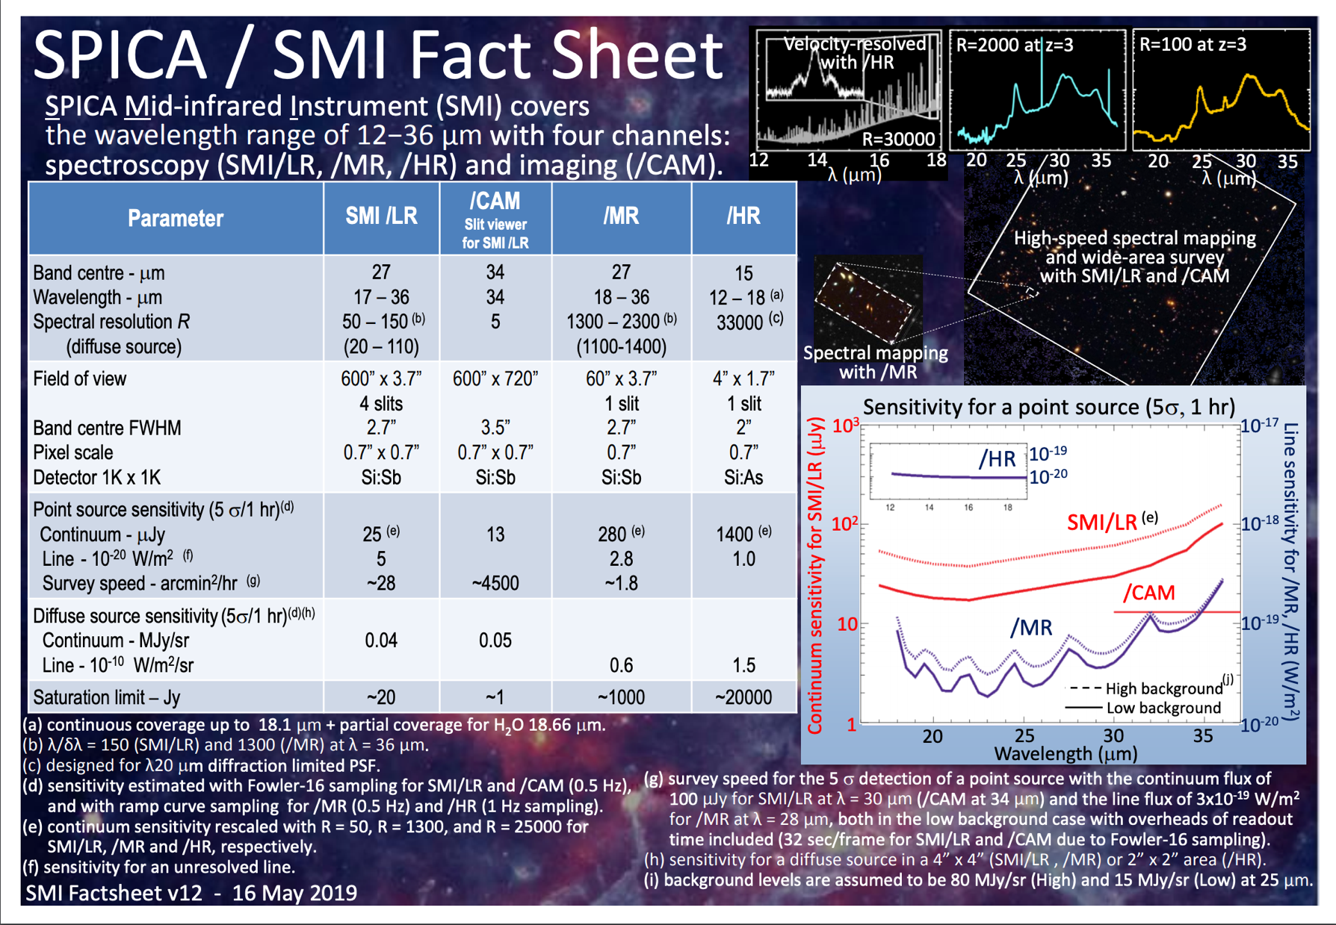

Slide 9
Spectral Simulations with NEMESIS
Giant Planets (L.N. Fletcher):
Forward model uses mid-IR line data sources and profiles approved by Cassini/Spitzer team (i.e., heritage).
Line-by-line calculations at 45 degree emission angle as a crude approximation of the disc-average.
Some missing gases in the model still (work in progress).
Titan (C. Nixon):
Temperature and gas profile are equatorial profiles derived from Cassini CIRS (Teanby et al. 2007, Vinatier et al. 2008a).
Forward model uses ktables and is disk-averaged using 10 emission angles.
Resolution is uniform in wavenumber:
JWST MIRI: 0.5 cm⁻¹
SPICA SMI HR: 0.025 cm⁻¹

Slide 10
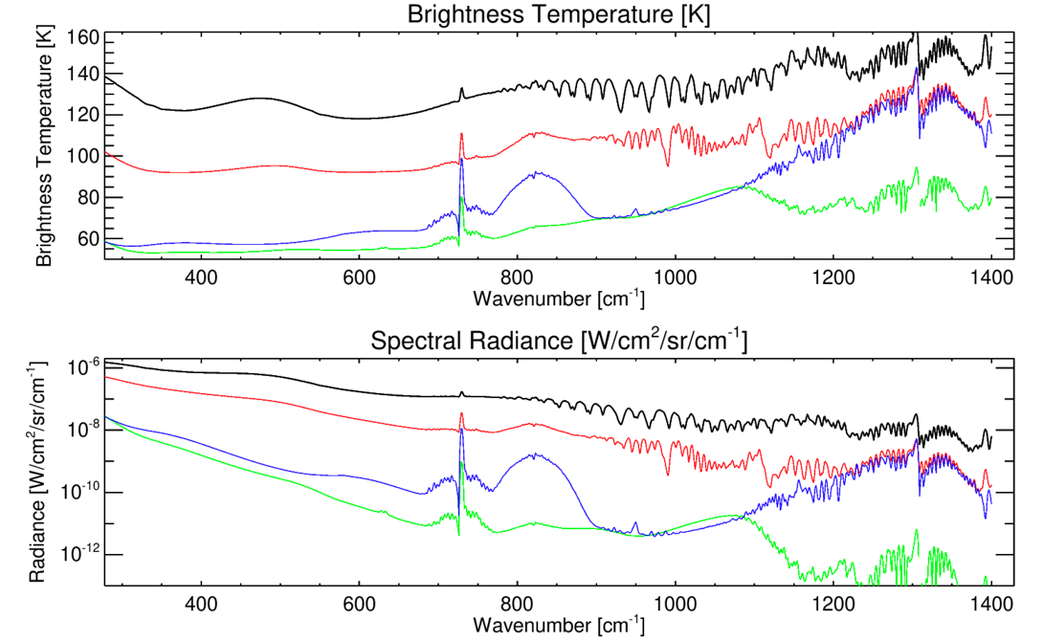
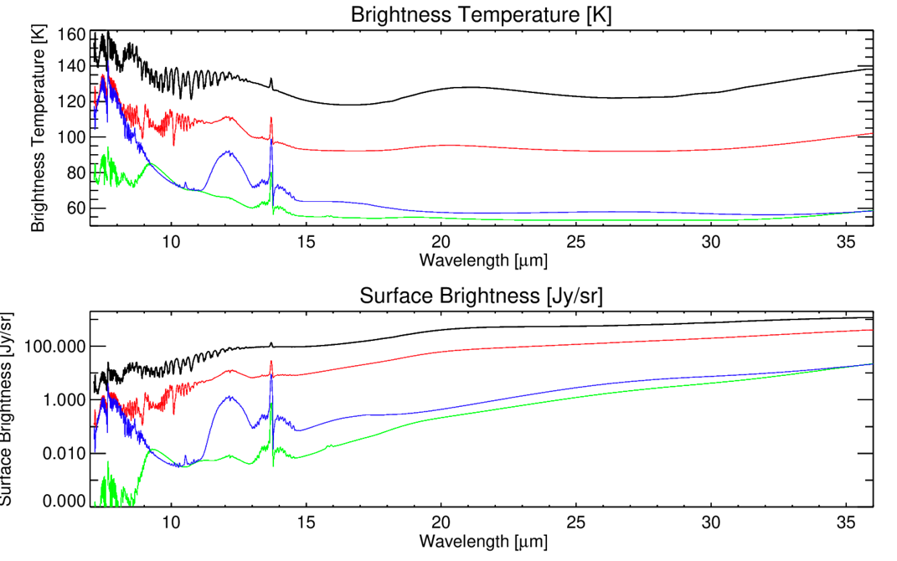
Giant Planet Overview Spectra
[Jy/arcsec²]
[Jy/arcsec²]
NEMESIS forward models at 2.5 cm-1 spectral resolution.
Jupiter (black), Saturn (red), Uranus (green), Neptune (blue).
Missing higher-order hydrocarbon features.
Demonstrate locations of key features and extensions to 7 µm.
Calculated for 45º emission angle viewing, single path (i.e., no disc integration).

Slide 11
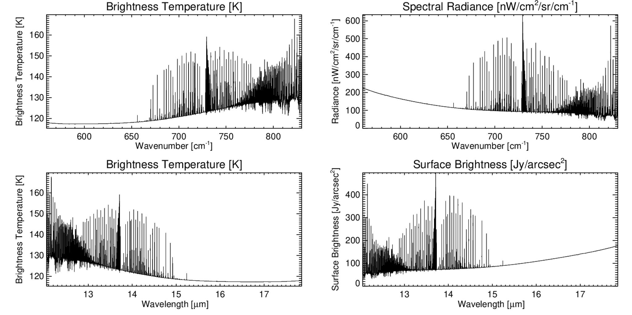
Jupiter SMI/HRS
Datafiles for download: https://github.com/leighfletcher/SPICA
Forward model @emm=45º
R=33,000
Line-by-line

Slide 12
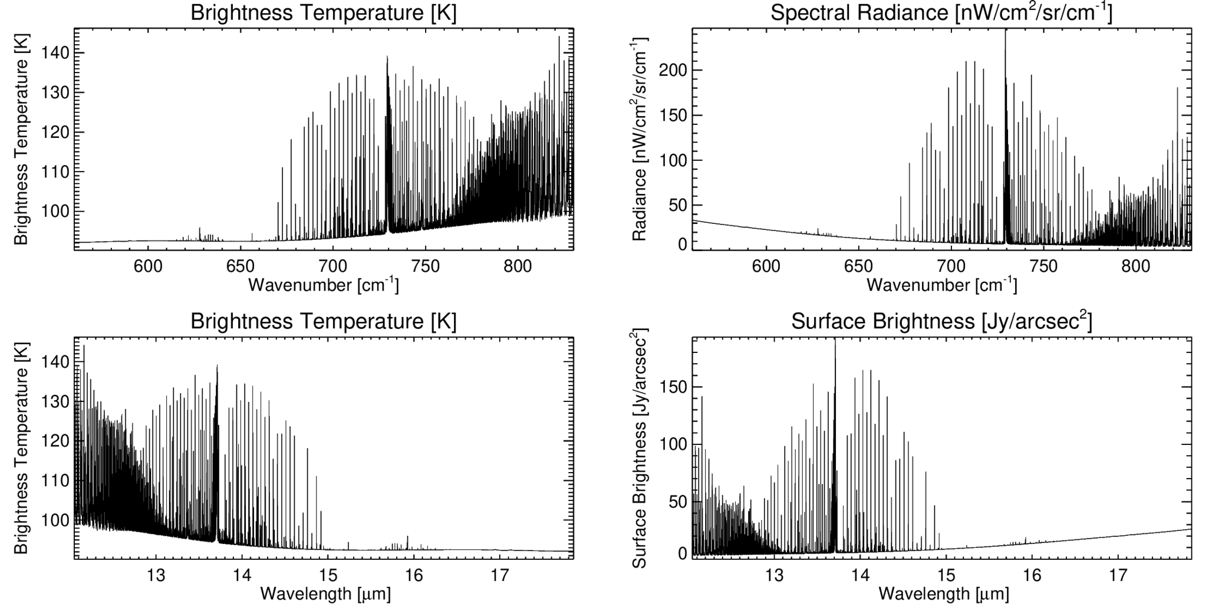
Saturn SMI/HRS
Datafiles for download: https://github.com/leighfletcher/SPICA
Forward model @emm=45º
R=33,000
Line-by-line

Slide 13
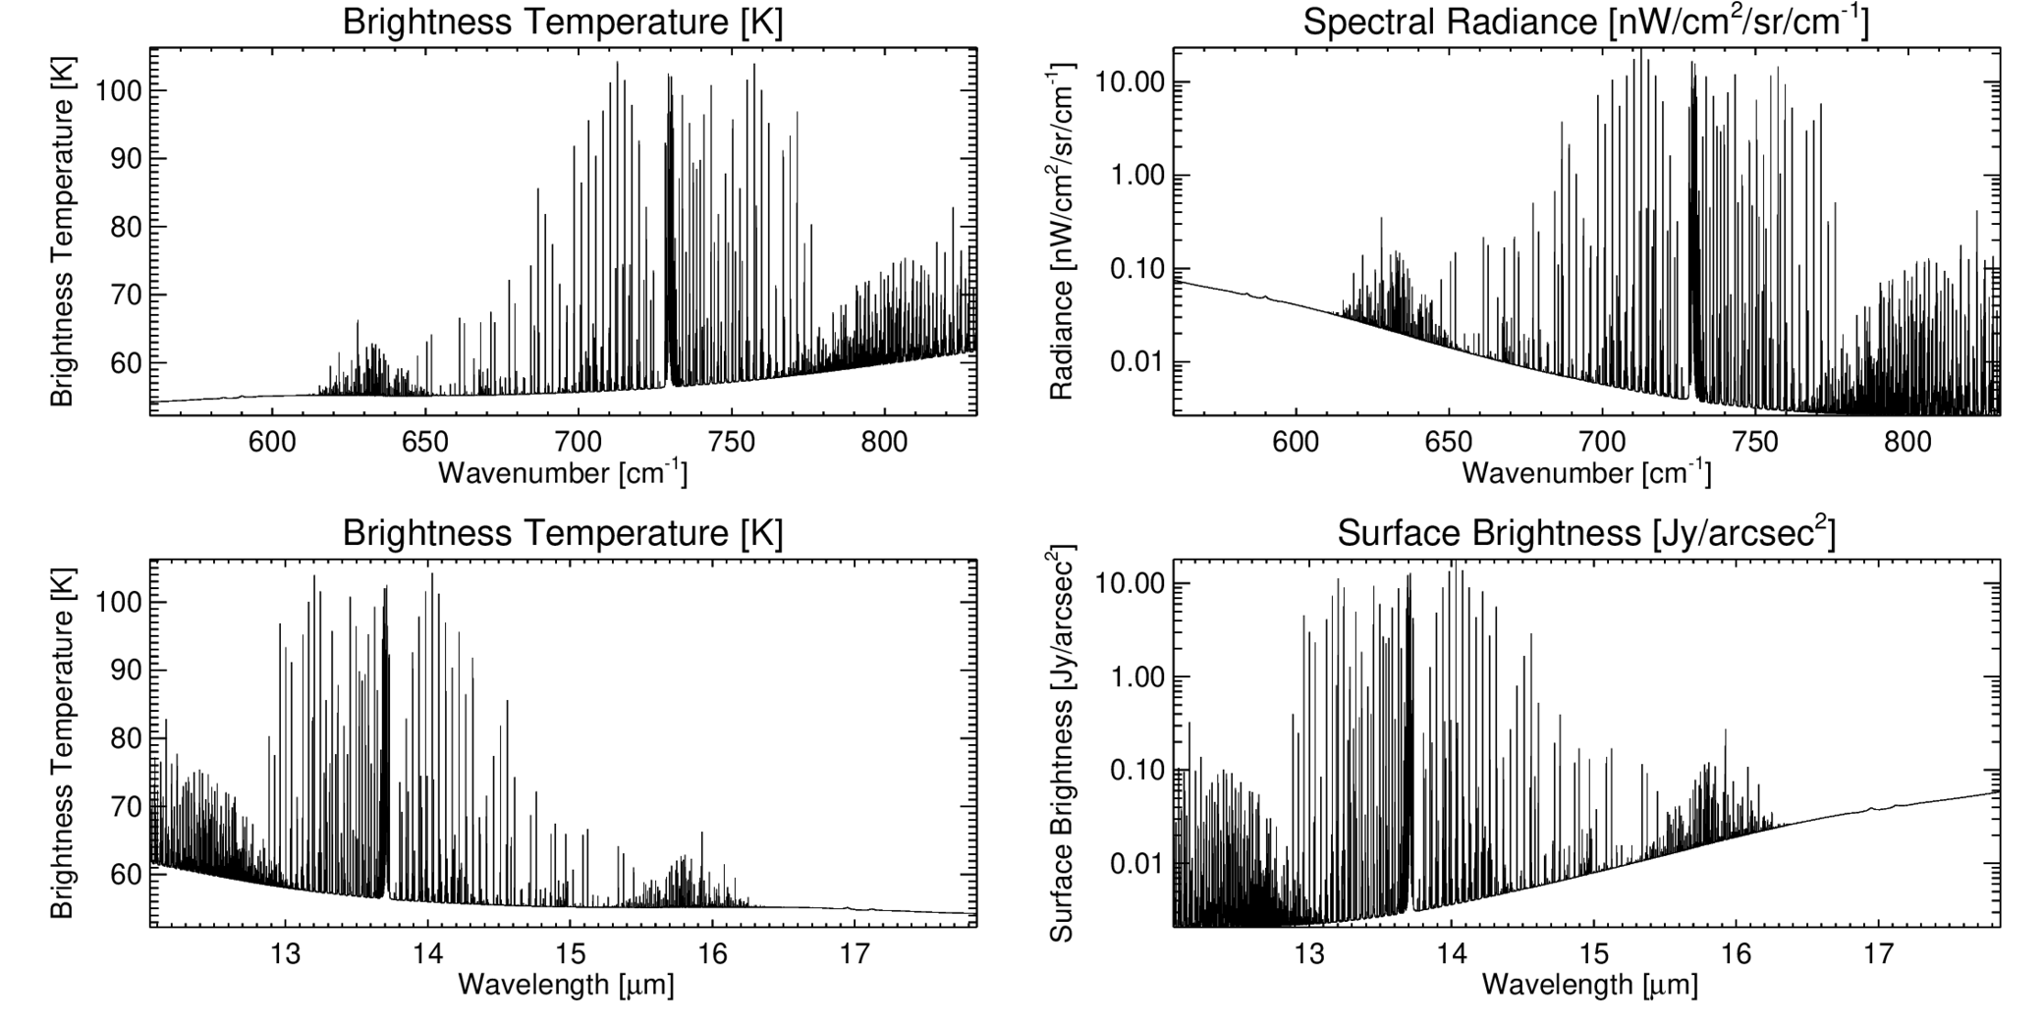
Uranus SMI/HRS
Datafiles for download: https://github.com/leighfletcher/SPICA
Forward model @emm=45º
R=33,000
Line-by-line
Missing H2 quadrupoles

Slide 14
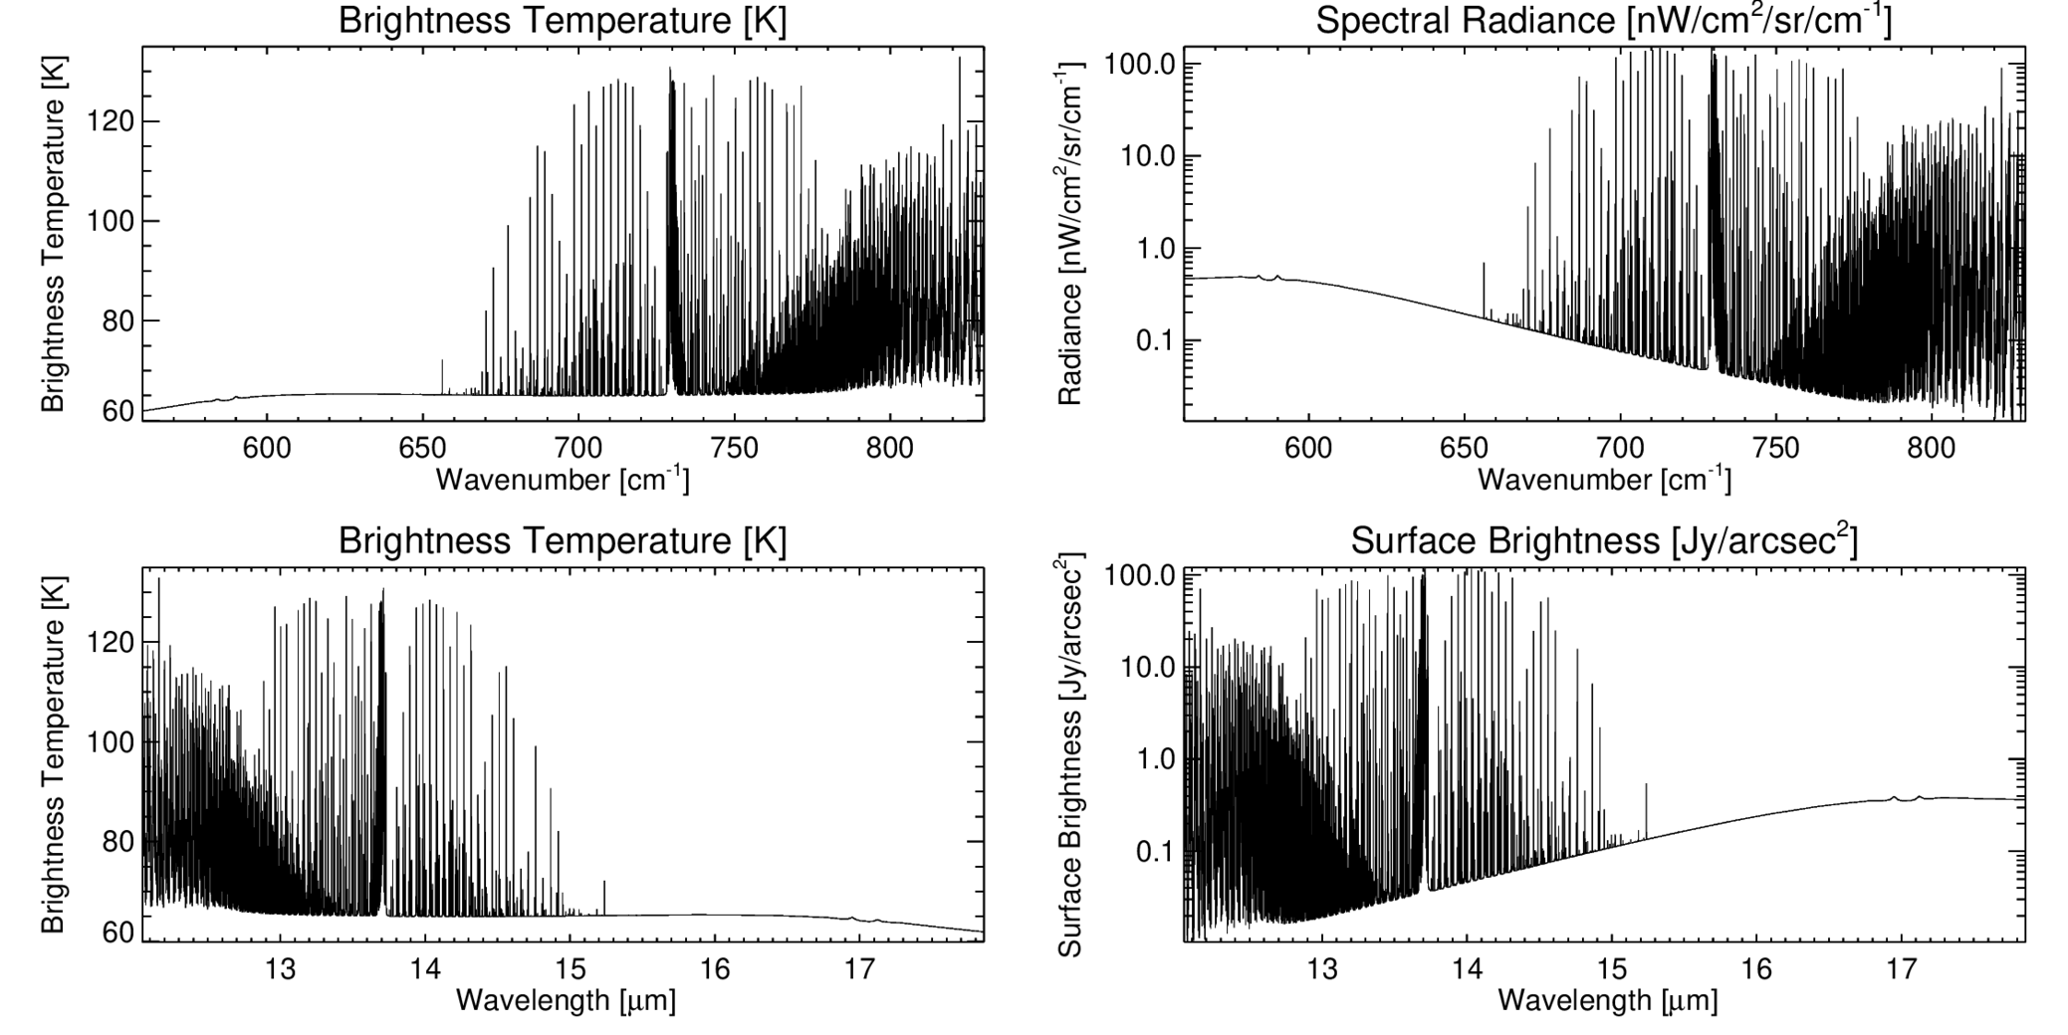
Neptune SMI/HRS
Datafiles for download: https://github.com/leighfletcher/SPICA
Forward model @emm=45º
R=33,000
Line-by-line
Missing H2 quadrupoles

Slide 15
Titan SMI/HRS – 600-700 cm-1
C₄H₂
HCN
C₃H₄
CO₂

Slide 16
Titan SMI/HRS – C2H2 and HCN
C₂H₂
HCN

Slide 17
Titan SMI/HRS HCN Isotopes

Slide 18
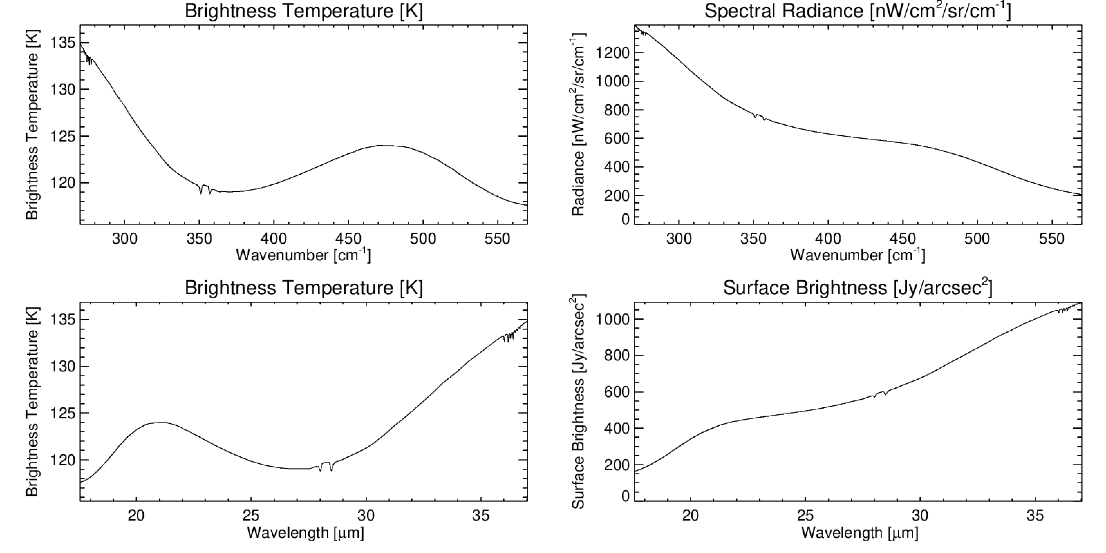
Jupiter SMI/MRS
Datafiles for download: https://github.com/leighfletcher/SPICA
Forward model @emm=45º
R=2,300
Line-by-line
Missing H2 quadrupoles

Slide 19
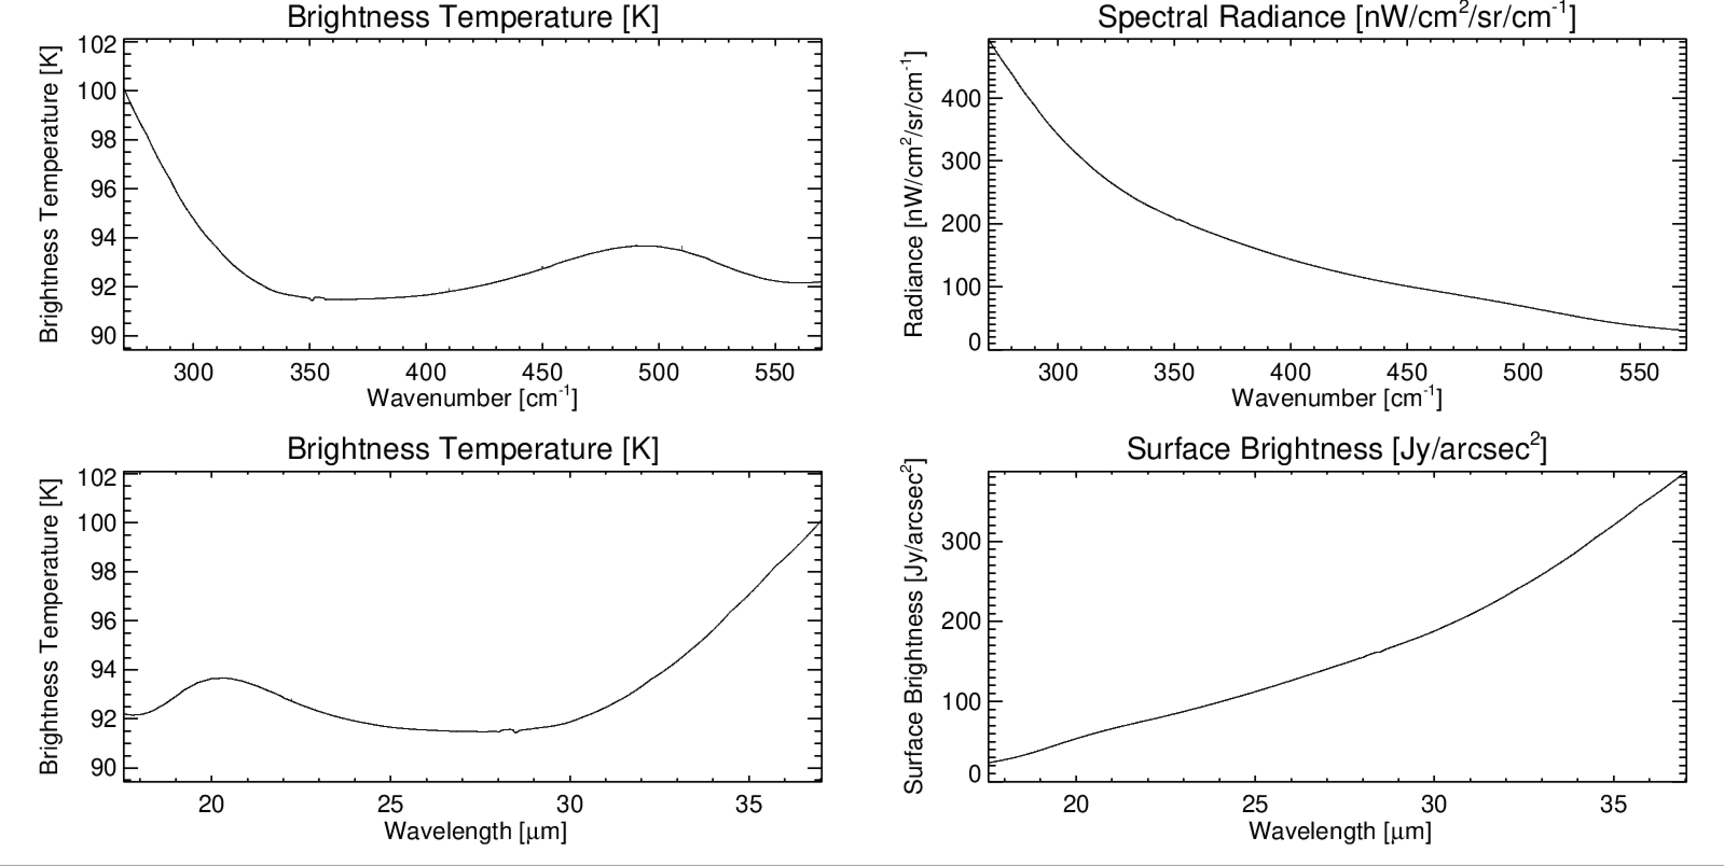
Saturn SMI/MRS
Datafiles for download: https://github.com/leighfletcher/SPICA
Forward model @emm=45º
R=2,300
Line-by-line
Missing H2 quadrupoles

Slide 20
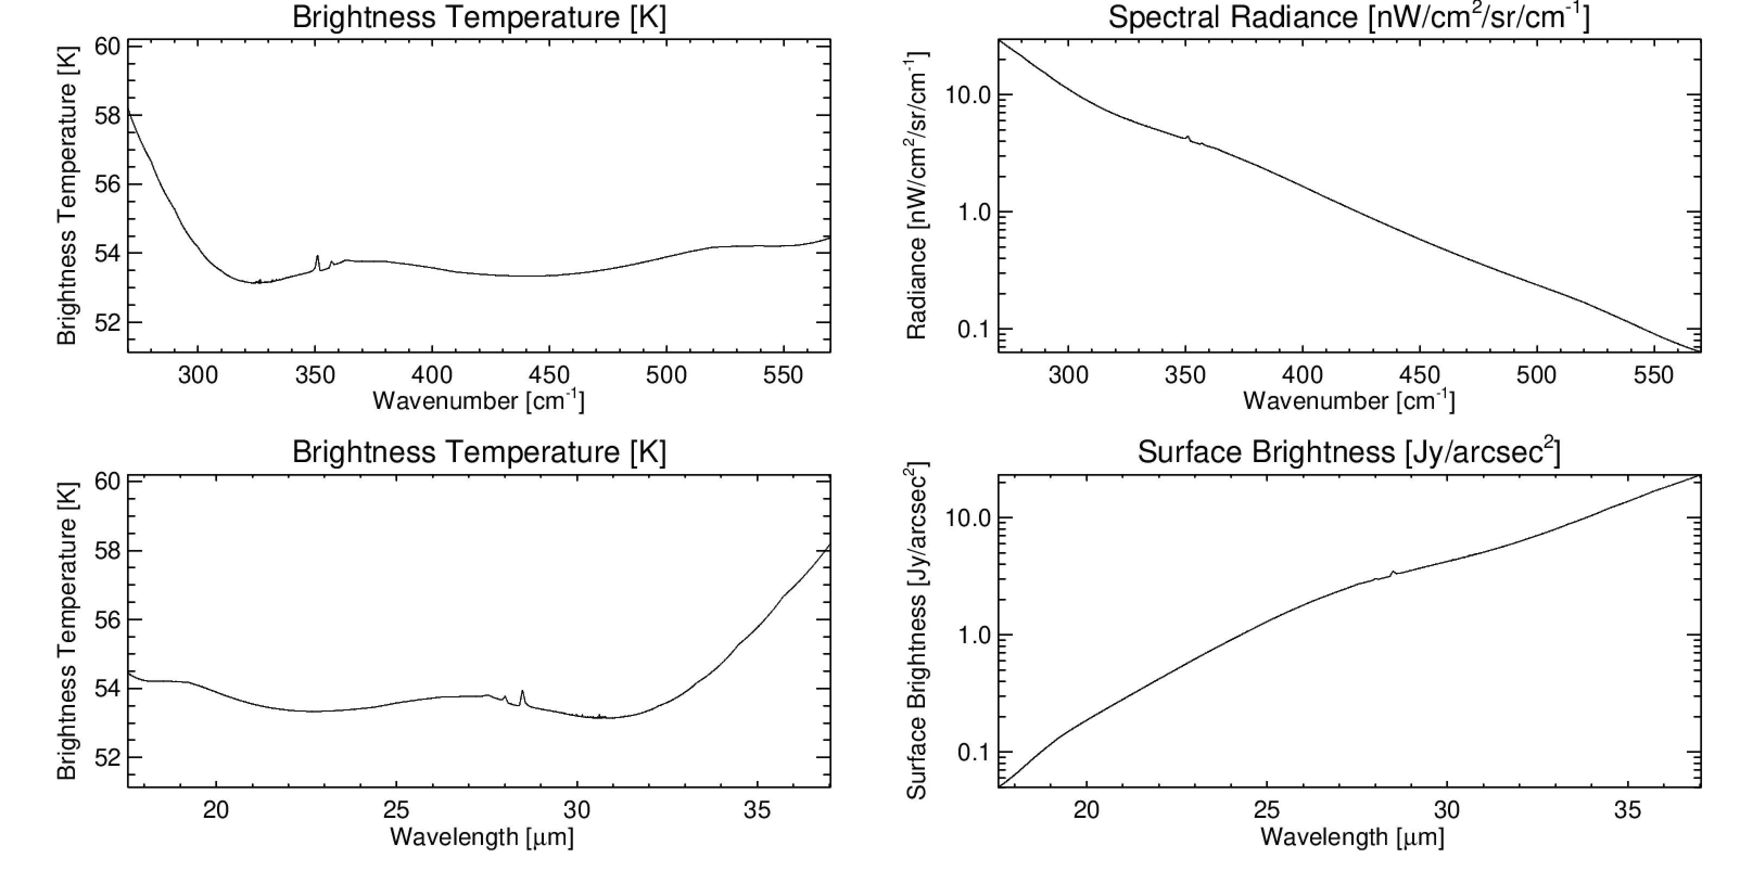
Uranus SMI/MRS
Datafiles for download: https://github.com/leighfletcher/SPICA
Forward model @emm=45º
R=2,300
Line-by-line
Missing H2 quadrupoles

Slide 21
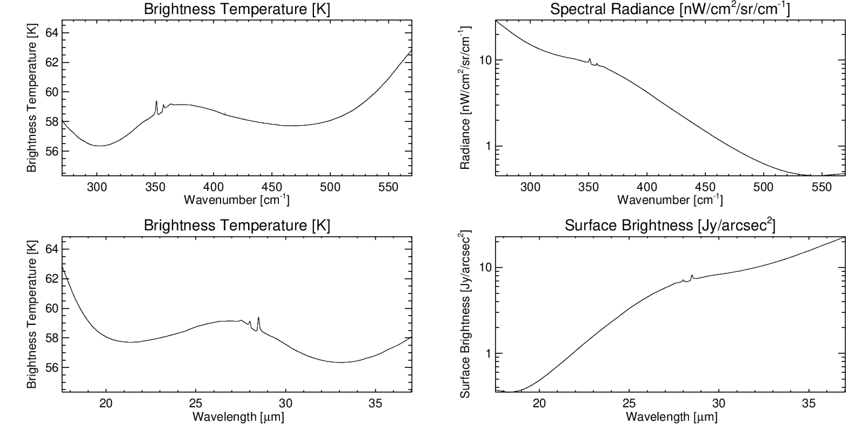
Neptune SMI/MRS
Datafiles for download: https://github.com/leighfletcher/SPICA
Forward model @emm=45º
R=2,300
Line-by-line
Missing H2 quadrupoles

Slide 22
Work to Do (February 2020)
Enhance spectral simulations of all four giants in SMI/HRS and SMI/MRS spectral ranges (and SAFARI while we’re at it).
Try varying individual gases and adding exotic species.
Find the missing quadrupoles….
Use spectral calculations for sensitivity/saturation study.
Develop the “chemical laboratories” idea into a use-case for the SPICA yellow book

Slide 23
NEMESIS Giant Planet Ktables (Work in Progress)
Current simulations use line-by-line, could improve efficiency with ktables?
SMI/HRS:
Triangular lineshape: FWHM=0.00045 µm (R=33,000 @15 µm)
Spectral sampling of 0.00010 µm (oversampled, 64000 points).
gases=['ch4','ph3','nh3_all','c2h6','c2h2','c2h4','ch3d','ch4_13C','h2’,'c4h2','c3h4','co2','c3h8','c6h6’]
NB: Also set a version running with 32000 points to test.
NB2: Some limitation from NEMESIS prevents me from sampling at this res, needed to use 0.0003 µm instead, 21000 points. Might need to break into smaller chunks.
SMI/MRS:
Triangular lineshape: FWHM=0.00783 µm (R=2300 @18 µm); ignore the degradation to R=1300 @36 µm for now.
Spectral sampling of 0.002 µm (oversampled, 9200 points).
Same gases.

Slide 24
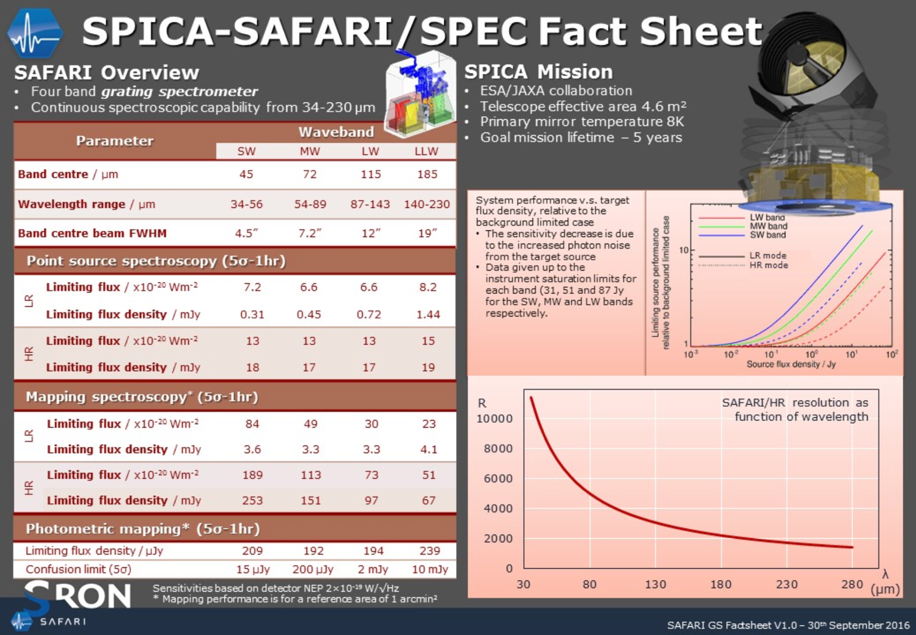

Slide 25
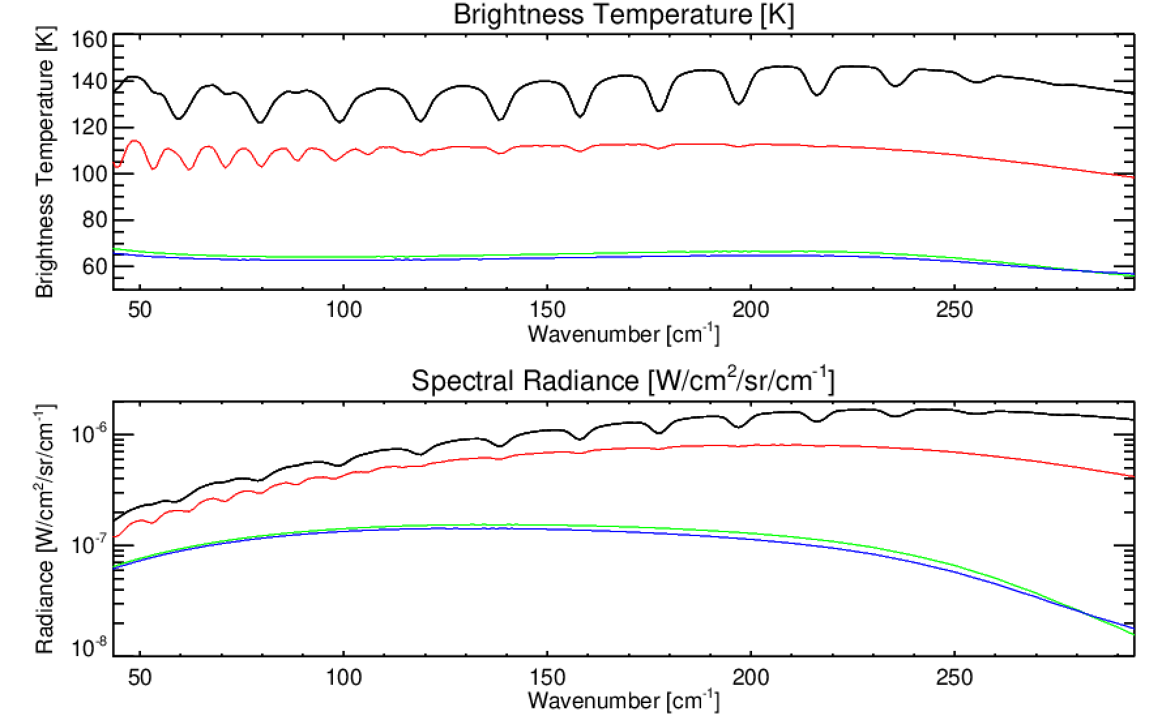
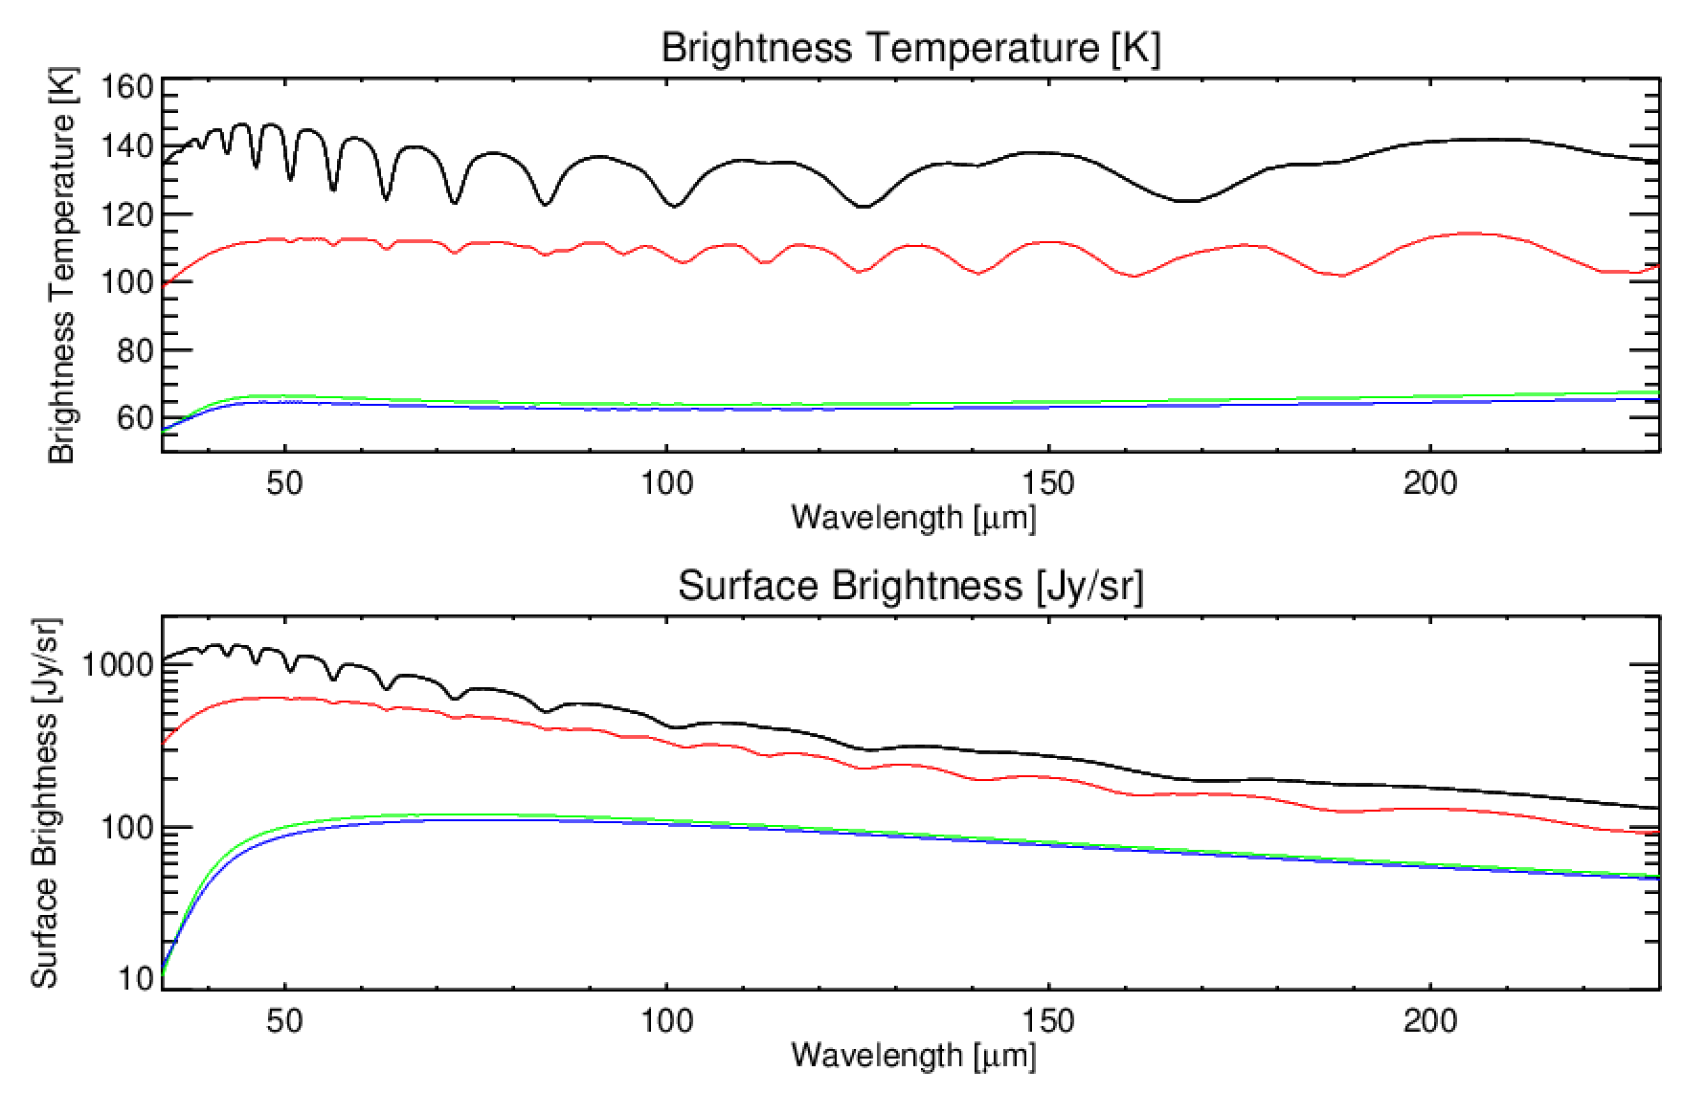
SPICA/SAFARI Calculations
[Jy/arcsec²]
[Jy/arcsec²]
Low-resolution calculation to show continuum brightness (but does not show narrow emission/absorption features).
Ammonia/phosphine lines show up for Jupiter and Saturn (black and red), but not for Uranus and Neptune (green and blue).
2.5 cm-1 resolution used, based on Cassini/CIRS and Spitzer/IRS models.

Slide 26
Giant Planet Opposition in 2032
Jupiter – July 19th 2032 (distance of 4.12 AU, and its disk will measure 46.8 arcsec in diameter, shining at magnitude -2.8).
Saturn – December 24th (distance of 8.03 AU, and its disk will measure 20.7 arcsec in diameter, shining at magnitude -0.5)
Uranus – December 20th (distance of 18.04 AU, and its disk will measure 3.9 arcsec in diameter, shining at magnitude 5.5)
Neptune – October 9th (distance of 28.85 AU, and its disk will measure 2.4 arcsec in diameter, shining at magnitude 7.8)
These are used in the calculations that follow.

Slide 27

Spectral Simulations with PSG
PSG – Planetary Spectrum Generator
https://psg.gsfc.nasa.gov/
Quick-look tool for planetary spectra.
Health warning:
predicted mid-IR spectra are often very wrong because of an inaccurate blend of gases (e.g., need to have correct abundance profiles added, Neptune database didn’t include CxHy species).
Assumed 1.7” beam size for HRS slitwidth, but FOV-integration techniques are unclear.
Solution: ALL of these need to be compared to NEMESIS forward models (work in progress, see end of presentation).

Slide 28
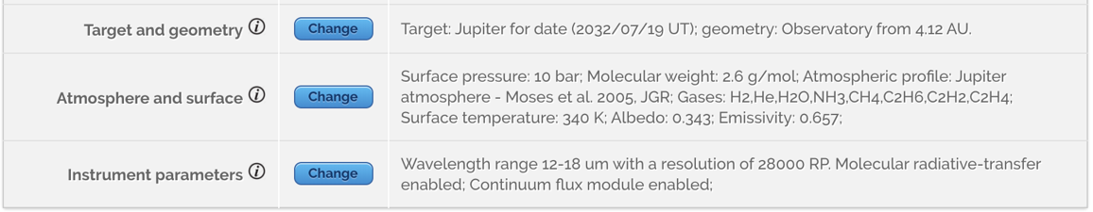
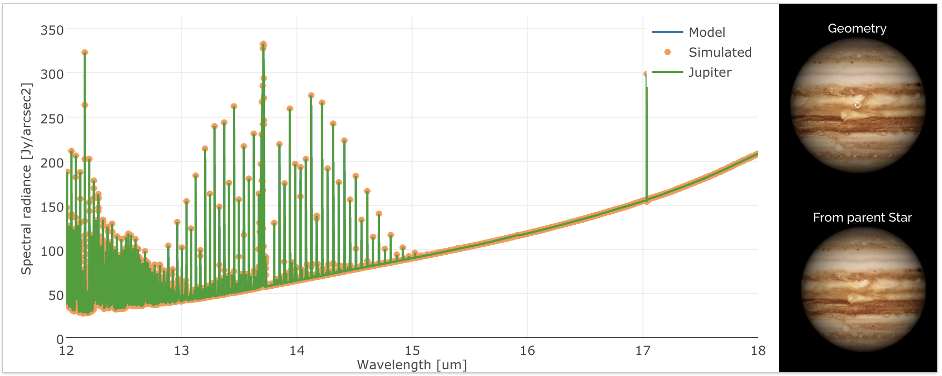
SMI/HRS Jupiter
1.7” beam

Slide 29
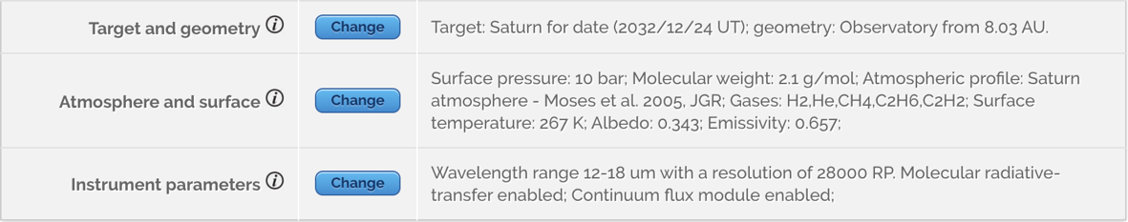
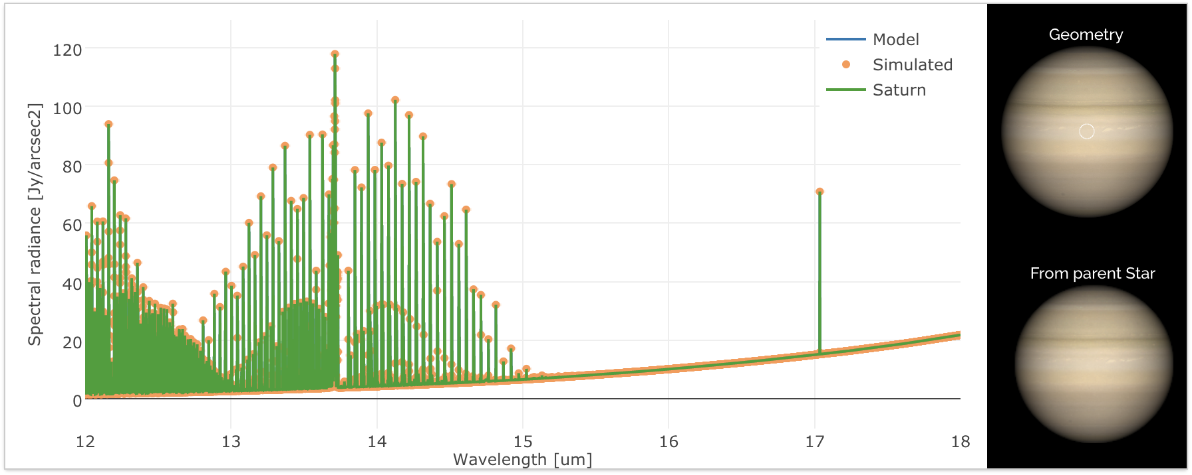
SMI/HRS Saturn
1.7” beam

Slide 30
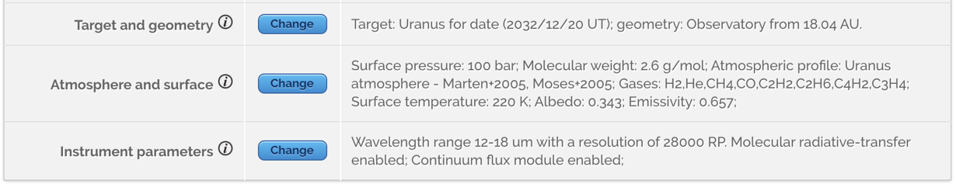
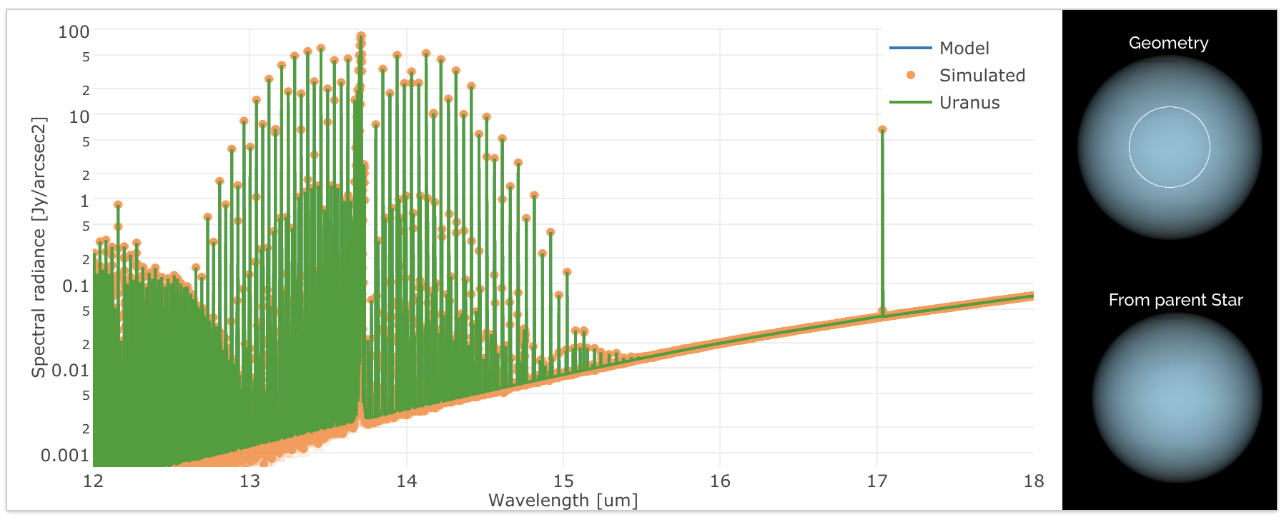
SMI/HRS Uranus
1.7” beam
Note: 0.1 ppm C2H2 and C2H6

Slide 31
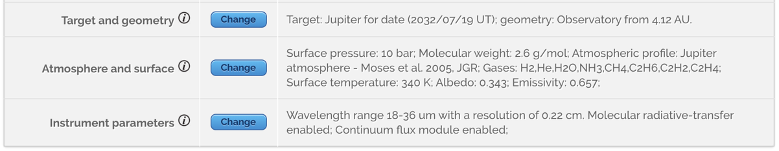
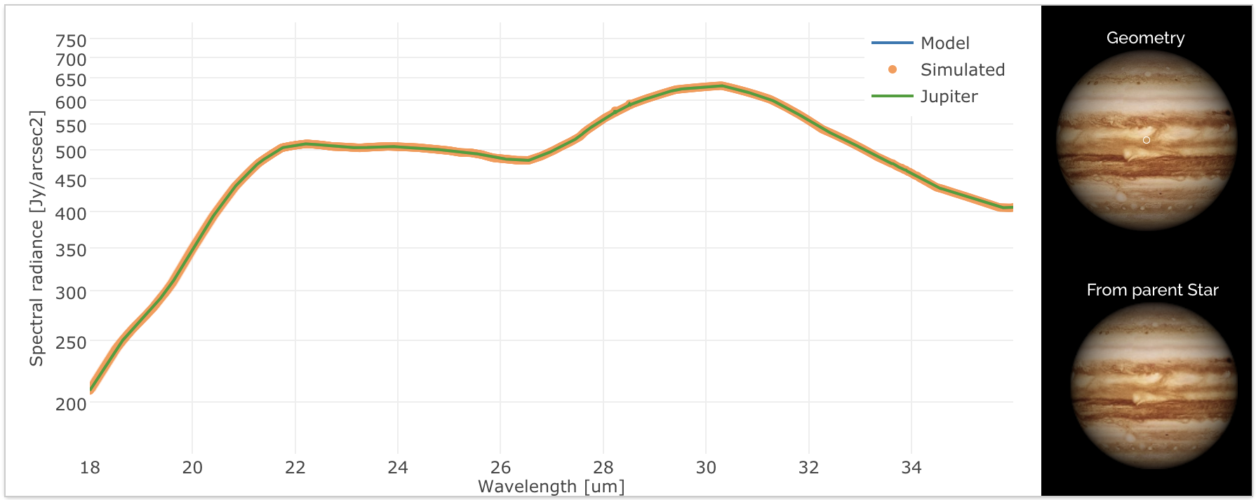
SMI/MRS Jupiter

Slide 32
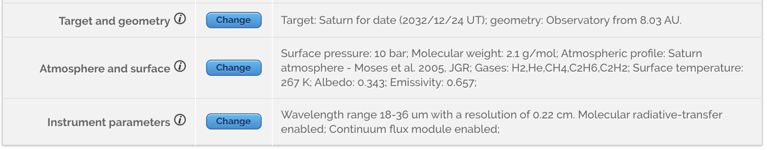
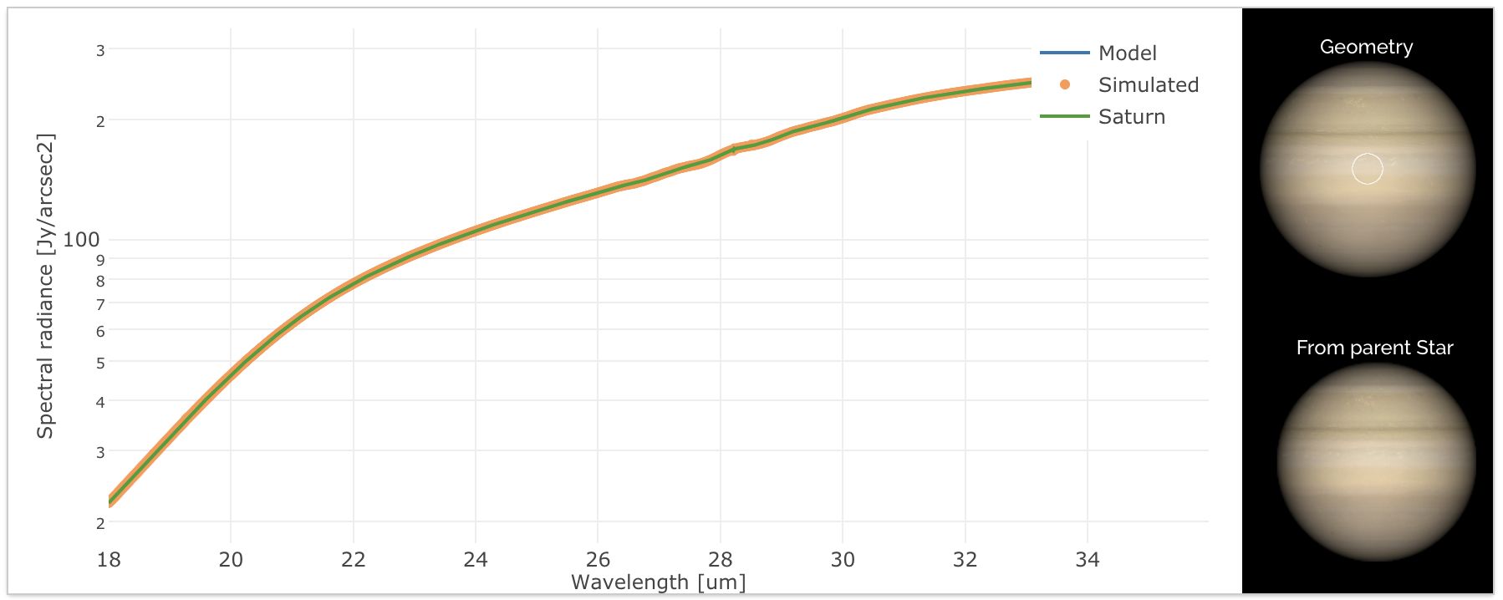
SMI/MRS Saturn

Slide 33
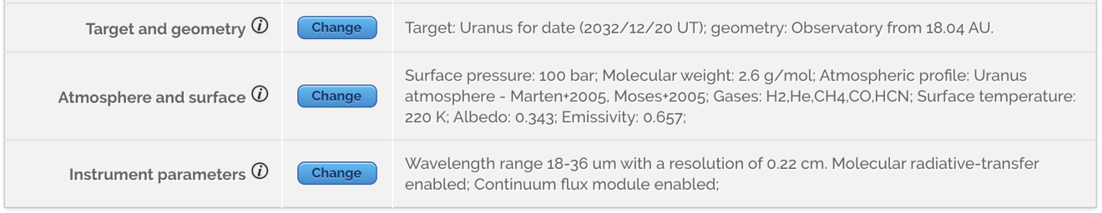
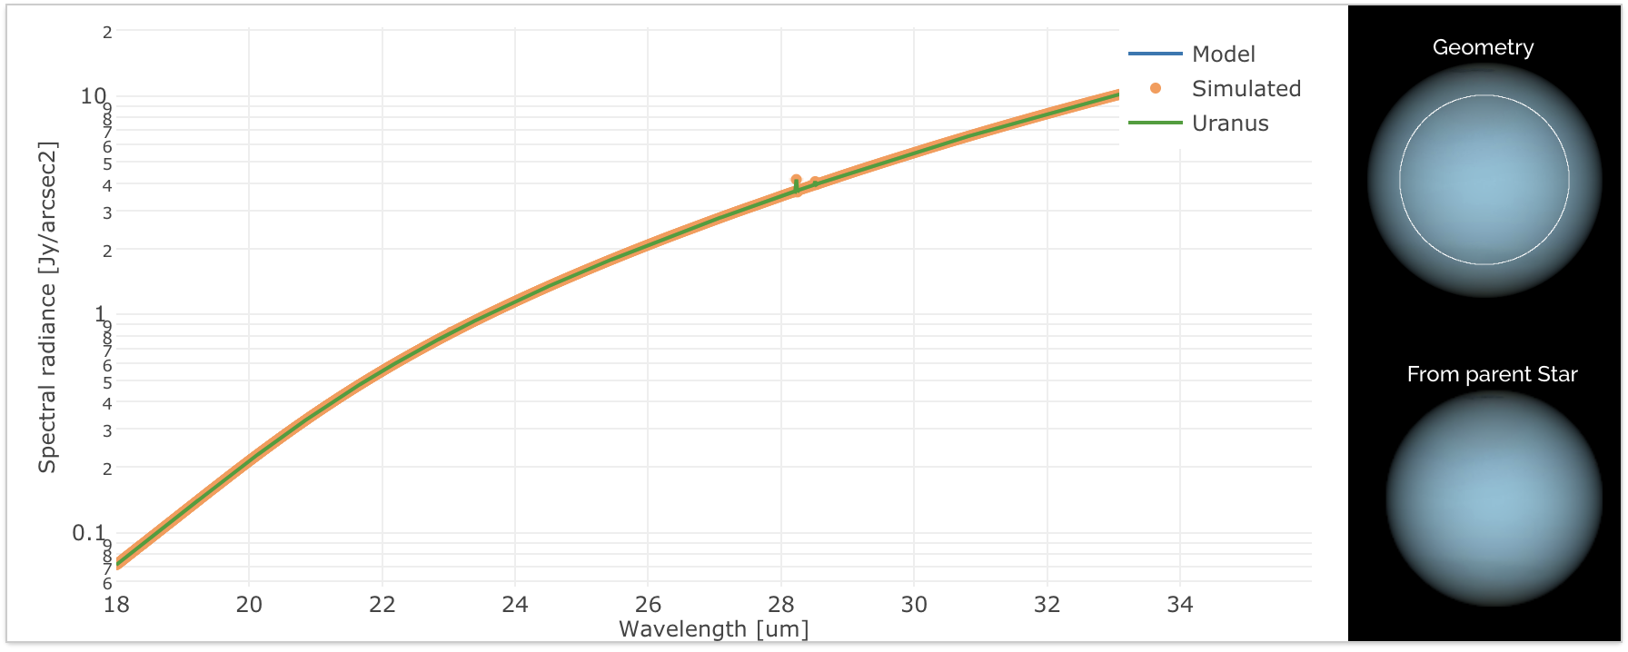
SMI/MRS Uranus

Slide 34
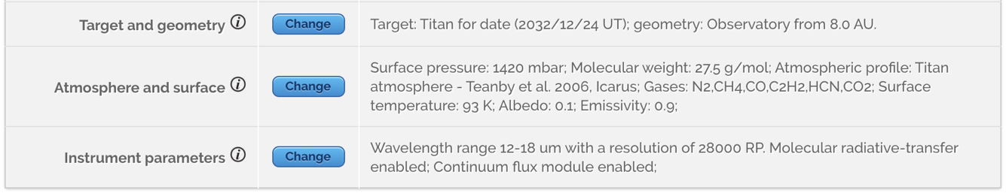
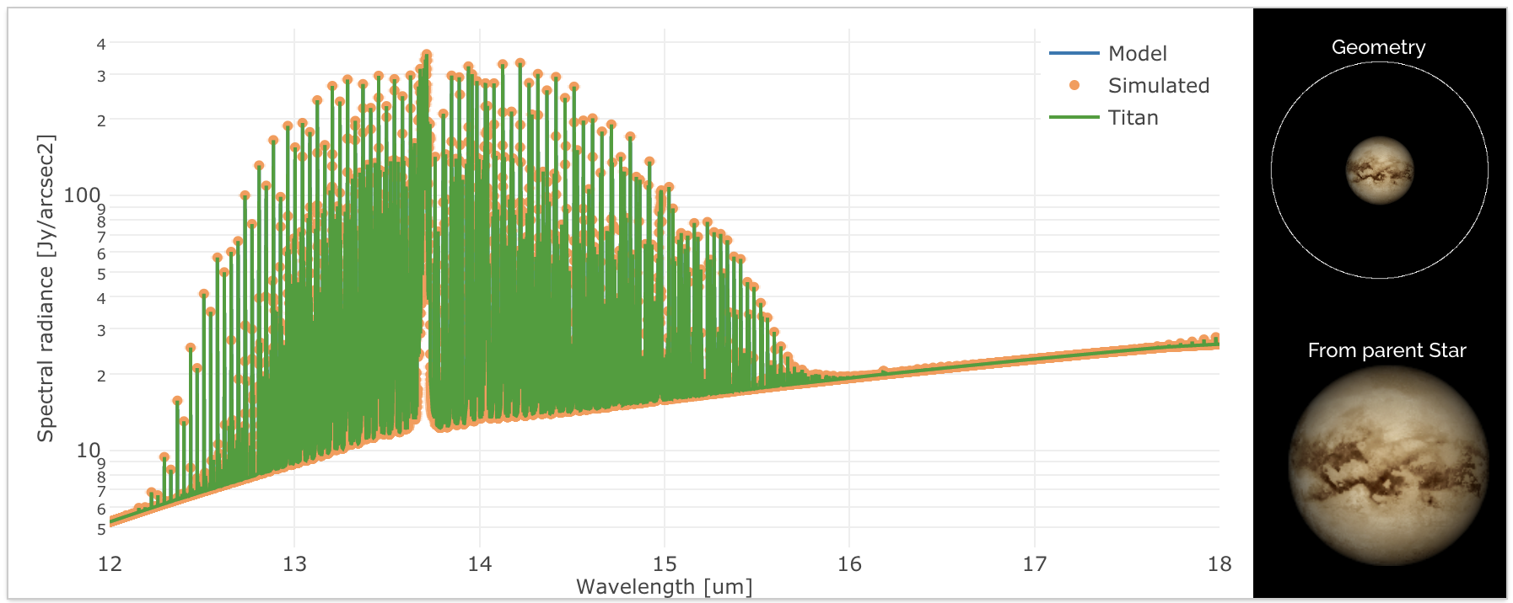
SMI/HRS Titan

